Slide 1

Manual For Check Effective rights
Version 2
Notes:
Peace be upon you...
Introducing Elm company has been linked to the innovation of a digital-based future for a number of reasons:
Elm 3.0 Strategy through which the company will launch integrated digital solutions in all its activities.
This trend is the global trend now, after increasing the new business models that changed the concept of the market into digital transformation.
Emphasizing that Elm will maintain its leadership by providing digital solutions based on the latest technology, which is the digital transformation throughout all the stages of the customer experience.
Emphasizing that Elm provides the latest technology solutions to its customers.
Showing that we are investing in the opportunities that support Vision 2030 and the Digital Transformation Program 2020.
Obtaining more information after satisfying the customer.
This slide prepares for the next slide (a short film about the global trend) and Elm‘s future trend towards digital transformation.

Slide 2
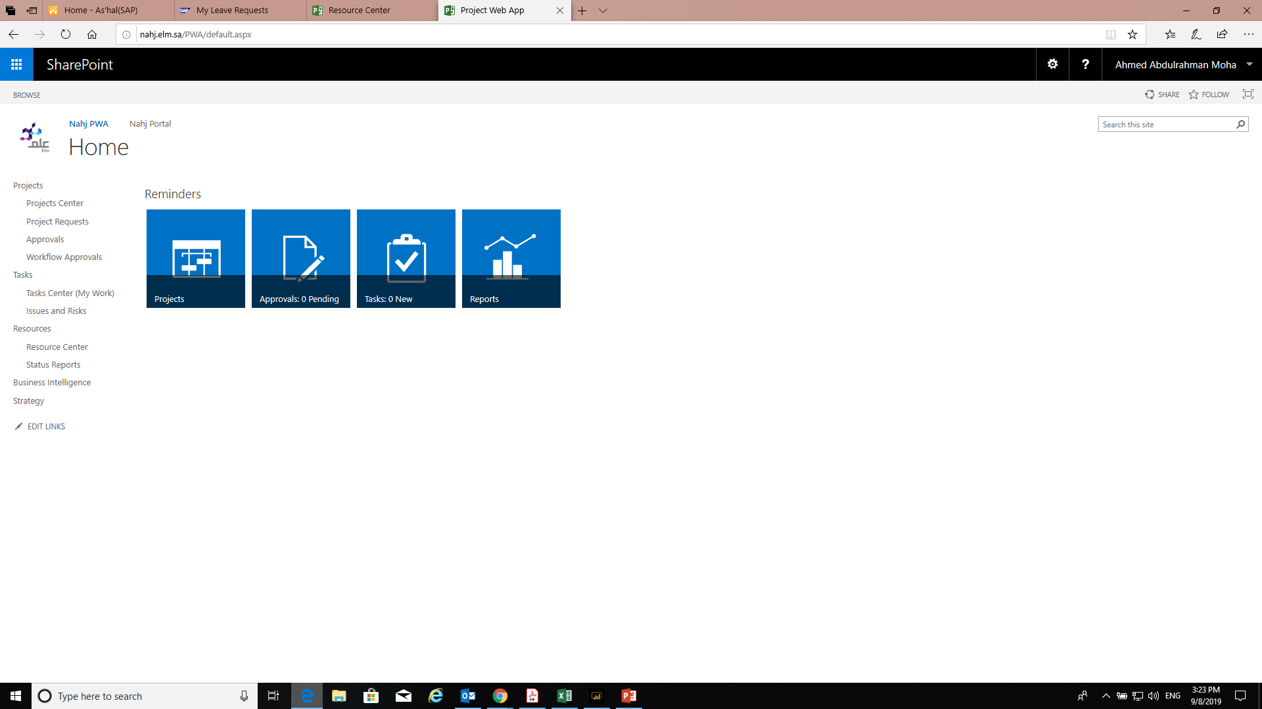
Go to →Go To nahj.elm.sa/pwa
Notes:
We start here by quickly introducing the most important phases that the company has passed by:
1986: We started as a research company for the National Information Center with the purpose of providing the best technical practices in the world and technology localization.
2002: We worked with the General Directorate of Passports to build secure electronic business, where we provided the exit and return visa. The work was limited to the Ministry of Interior sectors.
2007: The Royal Decree of King Abdullah, may Allah have mercy on him, was issued for transferring Elm into a joint stock company owned by the Public Investment Fund. After that, our services expanded.
2011: We launched our strategic plan to expand beyond e-business where we started working on:
Providing government outsourcing services: The operation of model Civil Affairs centers was the first project we launched, which achieved great success and was followed by services to all ministries and the private sector.
We also began to provide security training services.
2018: We moved to digital transformation through a clear strategy that keeps pace with the latest in digital technology in the world.
We can introduce the next slide with the following: "Having identified the company's growth journey, we move on to focus on the customer's journey as it is the most important aspect in our business and around which the Elm 3.0 strategy revolves ."

Slide 3
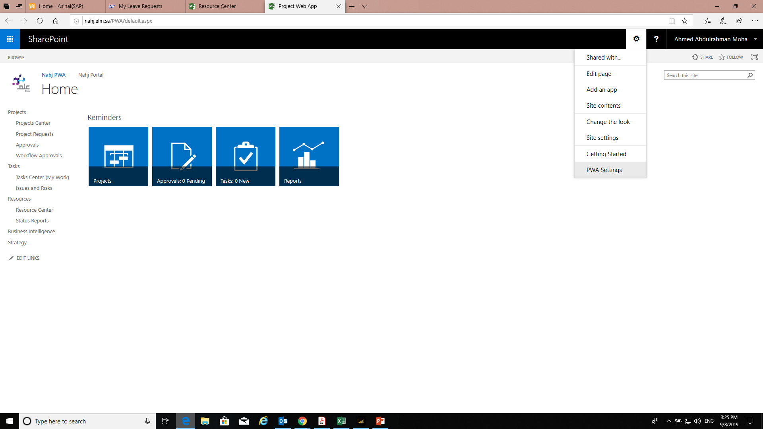
Go to →Go To PWA Settings

Slide 4
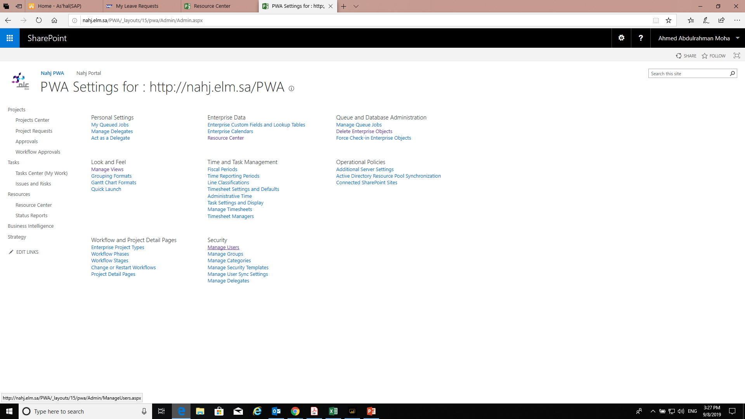
Go to →Go To Manage Users

Slide 5
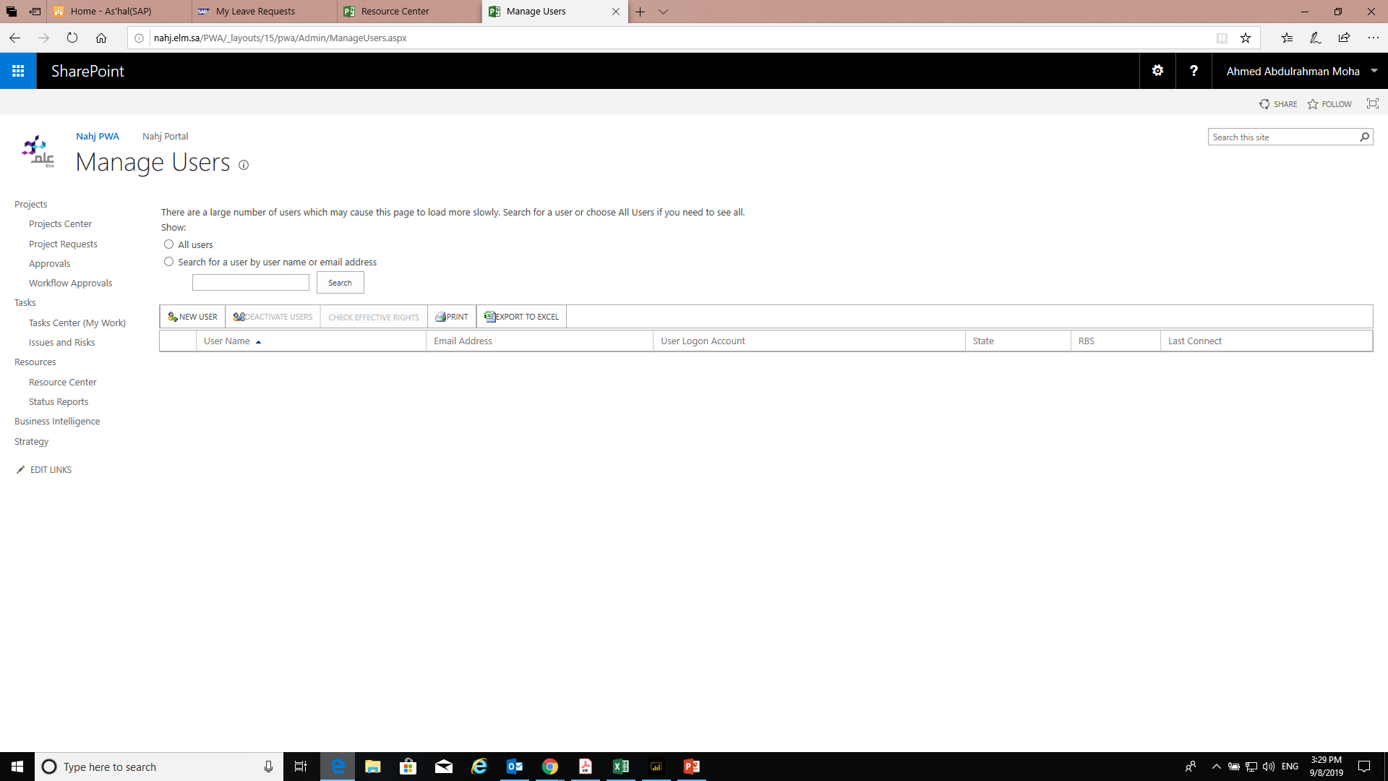
Go to →Go To Search then write the user name or email

Slide 6
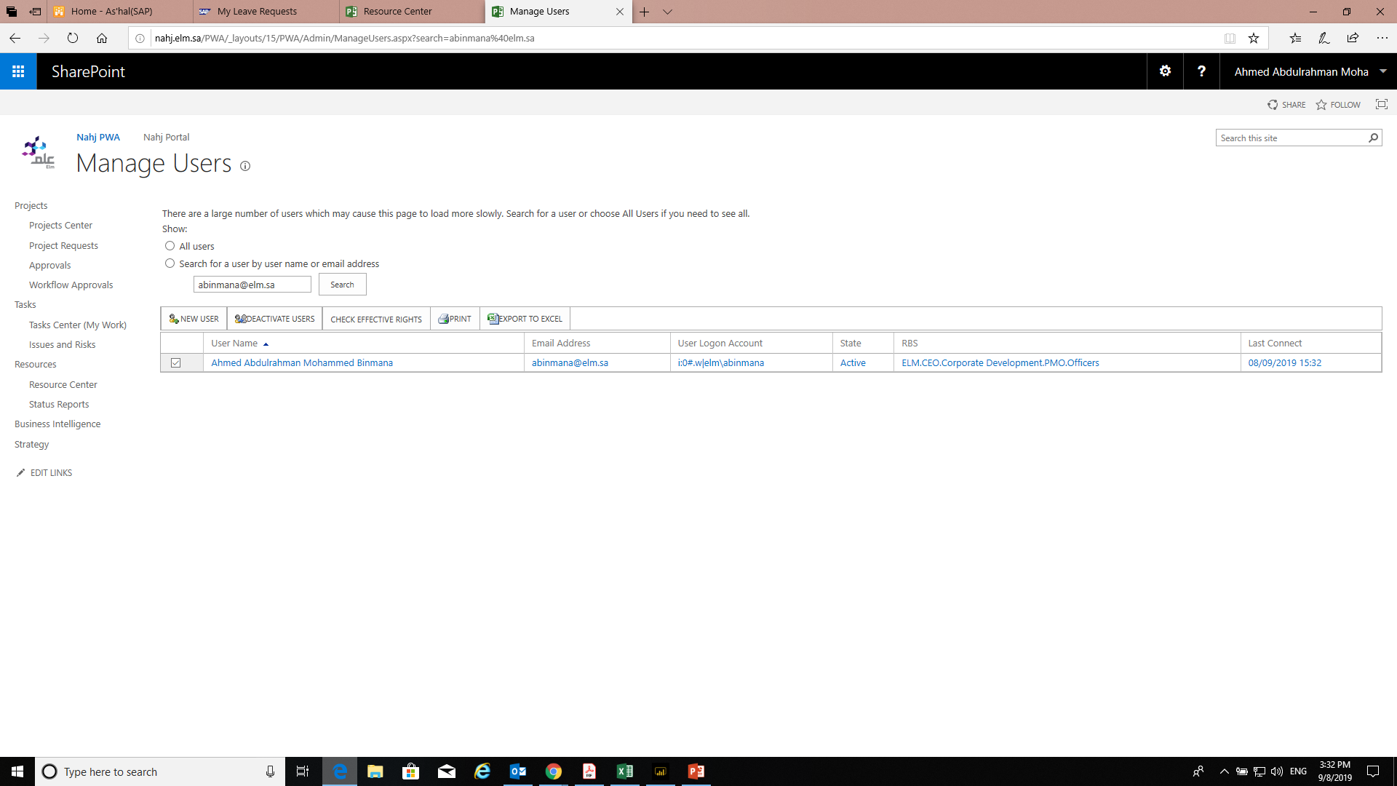
Then Go to →Then click on [“CHECK EFFECTIVE RIGHTS”]

Slide 7

Thank you..

